Slide 1

An Automated Java System for Adaptive Quiz Generation and Student Weak-Area Identification
Capstone Project
CSA0911-Programming in Java
Done By:
Anish Ebenezer (192511337)
N. Nesarajan(192511386)
Pushparaj(192421136)
Asif ali khan(192521009)
G. Sreekanth (192311422)
Guided By: Dr Thalapathi Rajasekaran R

Slide 2
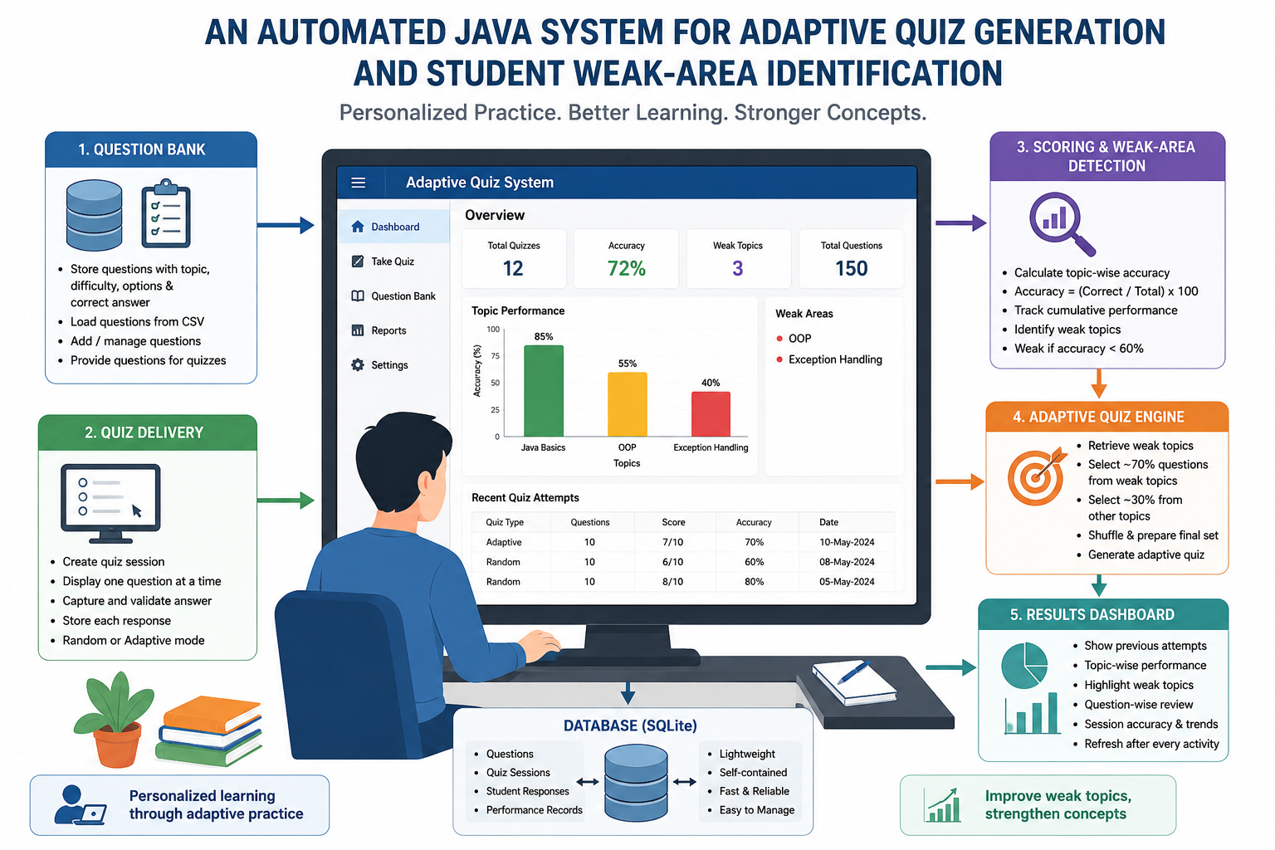
Introduction
Assessment plays an important role in measuring student learning.
Traditional quiz systems generally provide the same questions to all students.
These systems do not consider individual differences in student performance.
Strong students may repeatedly practice topics they already understand.
Weak topics may remain unnoticed without detailed performance analysis.
Manual identification of weak areas can take additional time.
The proposed system tracks student performance on a topic-wise basis.
It generates adaptive quizzes that focus more on the student's weak areas.

Slide 3
Problem Statement
Existing quiz systems mainly depend on fixed or random question selection.
The same type of questions may be given to students with different skill levels.
Student-specific weak areas are not automatically identified.
Teachers may have to manually examine quiz results.
Students may not receive sufficient practice in difficult topics.
Highly advanced adaptive testing systems can require complex statistical models.
Such systems may also require large datasets and computational resources.
Therefore, a simple and lightweight rule-based adaptive quiz system is needed.

Slide 4
Methodology
Develop a Java desktop application using Java Swing.
Use SQLite to store questions, quiz sessions, and student attempts.
Connect the application and database using JDBC.
Conduct quizzes and record every student response.
Calculate topic-wise accuracy from the stored responses.
Mark a topic as weak when its accuracy falls below 60%.
Generate the next quiz with approximately 70% weak-topic questions.
Use the remaining 30% questions from other topics and display the results on the dashboard.

Slide 5


Scope and Objective of the Project
Develop an automated quiz application using Java.
Create a centralized question bank for storing quiz questions.
Provide both random and adaptive quiz modes.
Calculate student performance for individual topics.
Automatically identify topics where the student needs improvement.
Generate follow-up quizzes based on previous performance.
Provide more practice questions from weak topics.
Display quiz history and performance through a dashboard

Slide 6
Literature Review
Year | Author / Study Focus | Existing System Features | Limitations Identified | Proposed Enhancement in Green Building Energy Monitoring & Sustainability Dashboard
2026 | Khare et al. – AI-Driven Online Quiz Assessment System | AI/LLM-based dynamic question generation and contextual quiz creation | Depends on external APIs and internet connectivity | Provides a self-contained offline question bank using Java and SQLite
2025 | Suresh et al. – Learning Assistant and Weakness Identification | Learning assessment, weak-area identification, recursive testing and skill improvemen | More complex learning-assistance approach; may require advanced processing | Provides a simple adaptive quiz mechanism using 60% threshold and 70/30 question selection
2023 | Shen et al. – Quiz-based Knowledge Tracing (QKT) | Uses knowledge tracing to track student knowledge and predict learning progress | Requires large datasets and high computational resources | Uses a lightweight rule-based approach suitable for small-scale applications
2025 | Ramadhan et al. – KuisQ Adaptive Real-Time Quiz Platform | Real-time adaptive quizzes, performance-based question adaptation, student engagement tracking | Limited structured topic-wise performance reporting | Provides topic-wise accuracy, weak-area detection, and detailed performance reporting

Slide 7
Tools Technologies
Category | Technology
Programming Language | Java
Version | JDK 17+
User Interface | Java Swing
Database | SQLite
Database Connectivity | JDBC
Data Import | CSV
Adaptation Technique | Rule-Based
Application Type | Desktop Application

Slide 8
Module 1- Question Bank & Data Management
Manages and stores all quiz questions.
Uses an SQLite database for question storage.
Stores topic, difficulty, question, options, and correct answer.
Automatically initializes the database during the first run.
Provides built-in questions across multiple topics.
Supports bulk question loading through a CSV file.
Allows users to add questions through the application.
Retrieves questions based on topic or question ID when required.

Slide 9
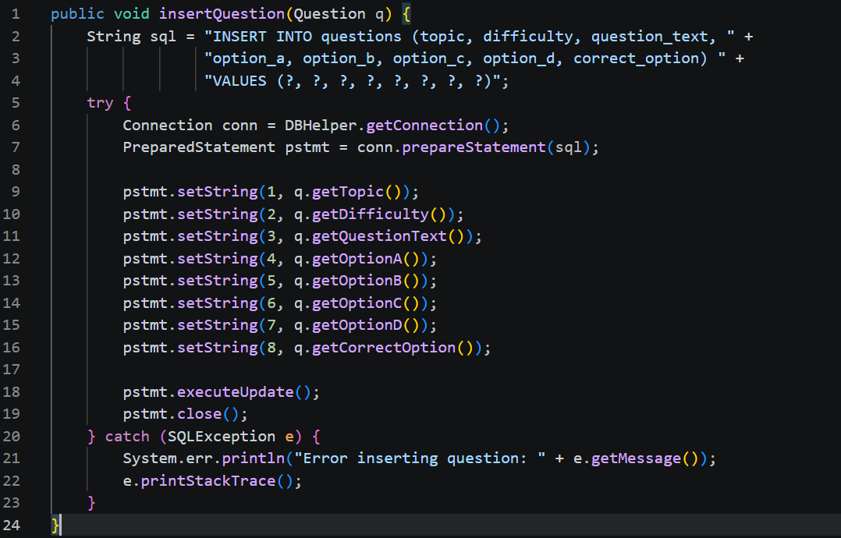
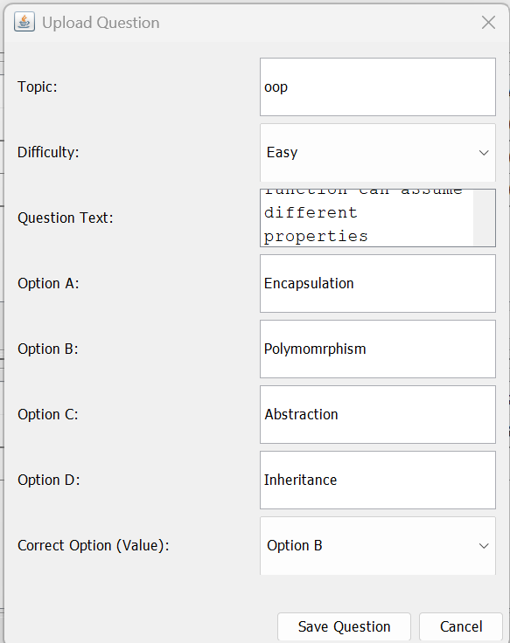
Module 1- Question Bank & Data Management

Slide 10
Module 2- Quiz Delivery & Response Capture
Creates a new quiz session whenever a quiz begins.
Records whether the quiz is Random or Adaptive.
Displays one question at a time through the Swing interface.
Provides four answer options using radio buttons.
Shows the current progress of the quiz.
Checks whether the student has selected an answer.
Compares the selected answer with the correct answer.
Stores each student response in the database for further analysis.

Slide 11
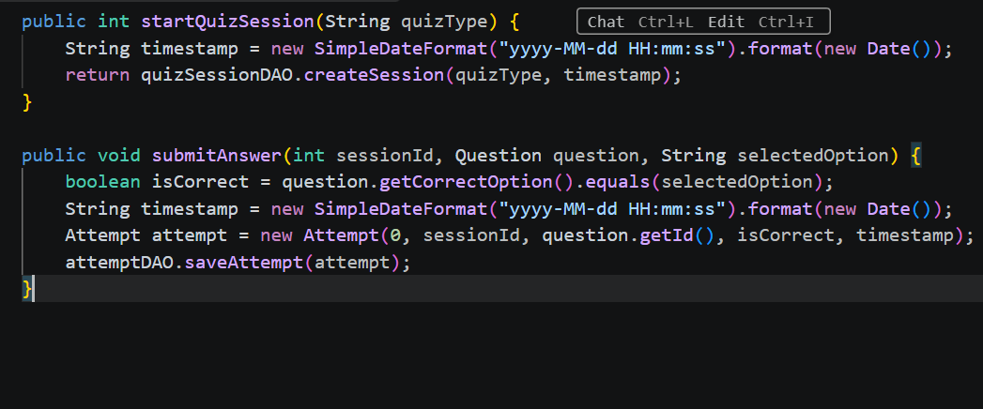
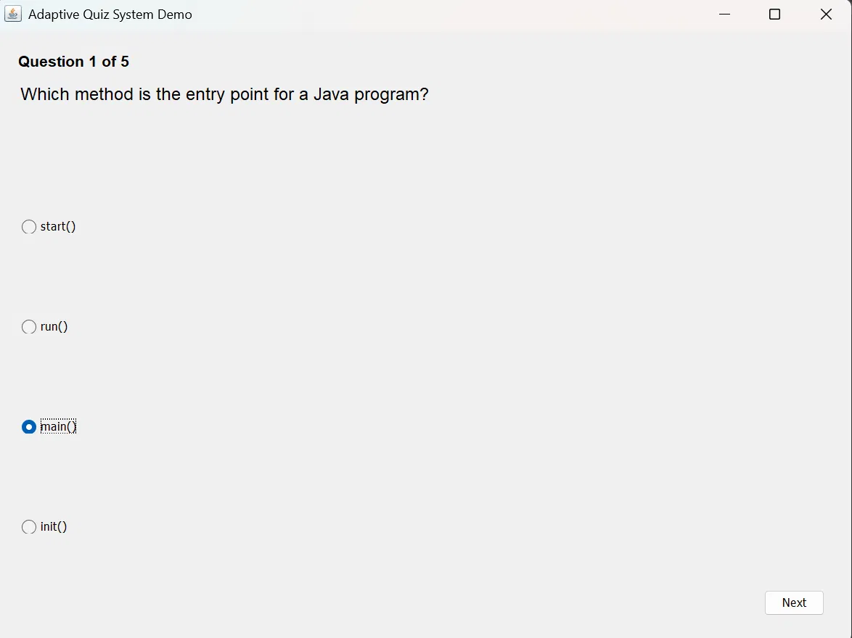
Module 2- Implementation

Slide 12
Module 3- Performance Scoring & Weak-Area Detection
Analyzes the answers submitted by the student.
Calculates accuracy for each individual topic.
Uses the student's complete quiz history for cumulative analysis.
Tracks the total number of questions attempted in each topic.
Uses the 60% accuracy threshold for weak-area identification.
Topics below 60% are automatically marked as weak.
Session-specific performance can also be calculated.
The detected weak areas are provided to the Adaptive Quiz Engine.

Slide 13
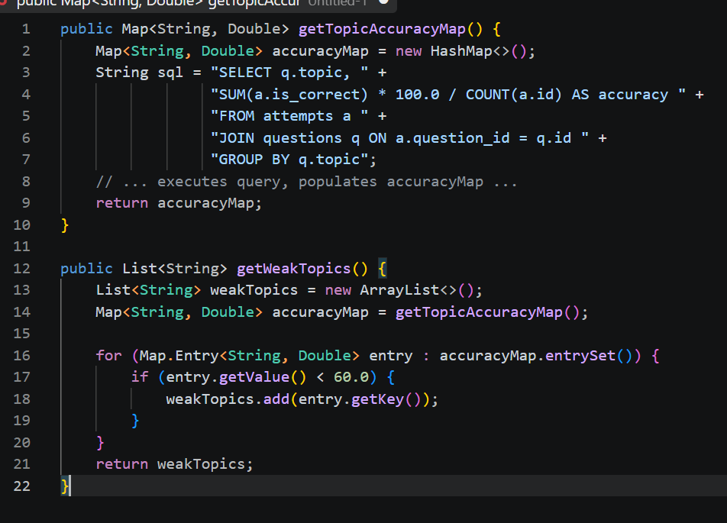
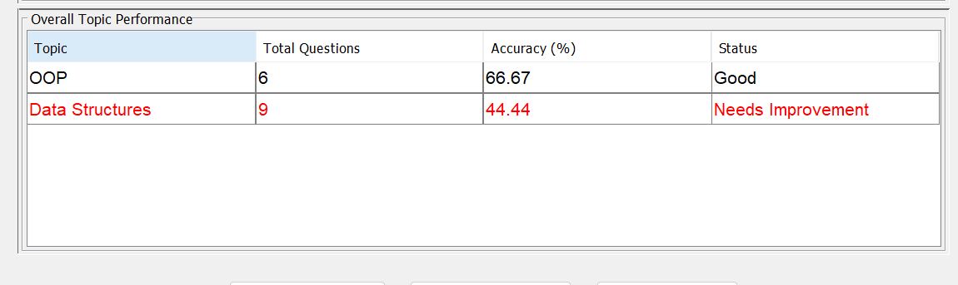
Module 3- Performance Scoring & Weak-Area Detection

Slide 14
Module 4- Adaptive Quiz Generation Engine
Retrieves the latest weak topics from the scoring module.
Creates separate question pools for weak and other topics.
Selects approximately 70% of questions from weak topics.
Selects approximately 30% of questions from other topics.
Randomly shuffles the selected question pools.
Uses additional questions if one question pool has insufficient questions.
Performs a final shuffle before displaying the quiz.
If no weak topic is available, the system generates a random quiz.

Slide 15
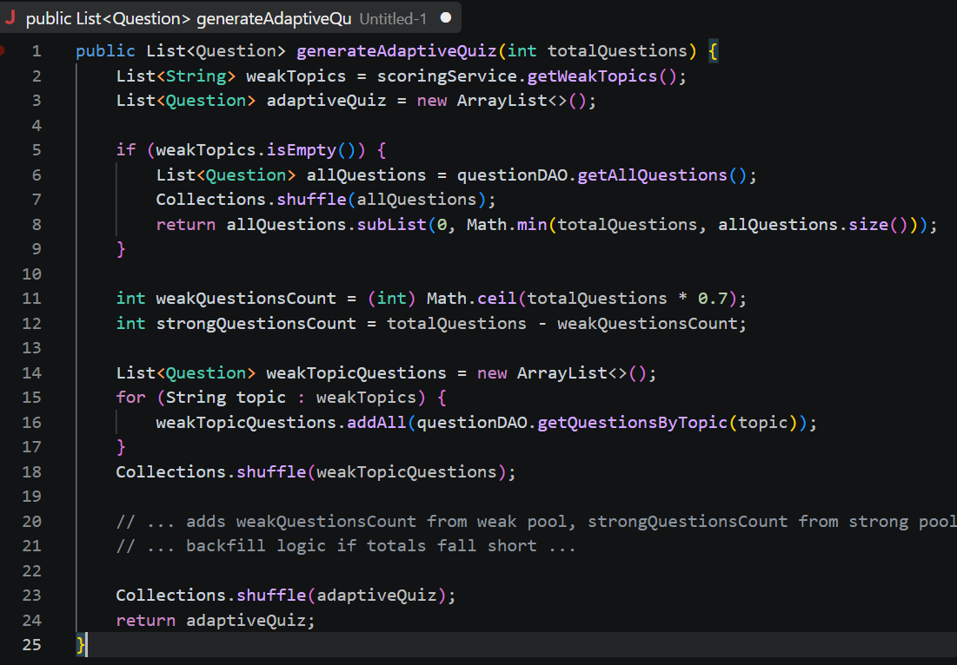
Module 4- Adaptive Quiz Generation Engine

Slide 16
Module 5- Results Dashboard & Progress Reporting
Displays the student's previous quiz attempts.
Shows overall topic-wise performance.
Highlights weak topics for easy identification.
Displays a “Needs Improvement” status for weak areas.
Allows students to review previous quiz attempts.
Provides question-by-question correctness details.
Shows session accuracy and topic-wise performance.
Automatically refreshes the dashboard after quiz completion or data changes.

Slide 17
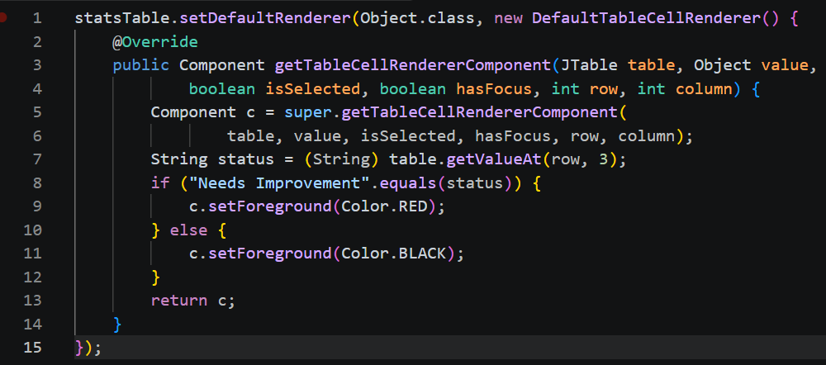
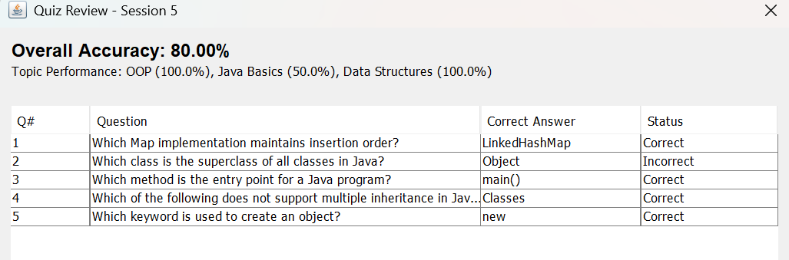
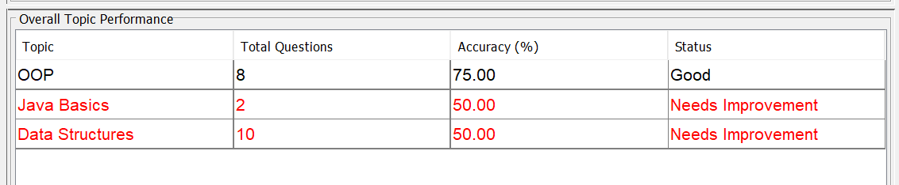
Module 5- Results Dashboard & Progress Reporting

Slide 18
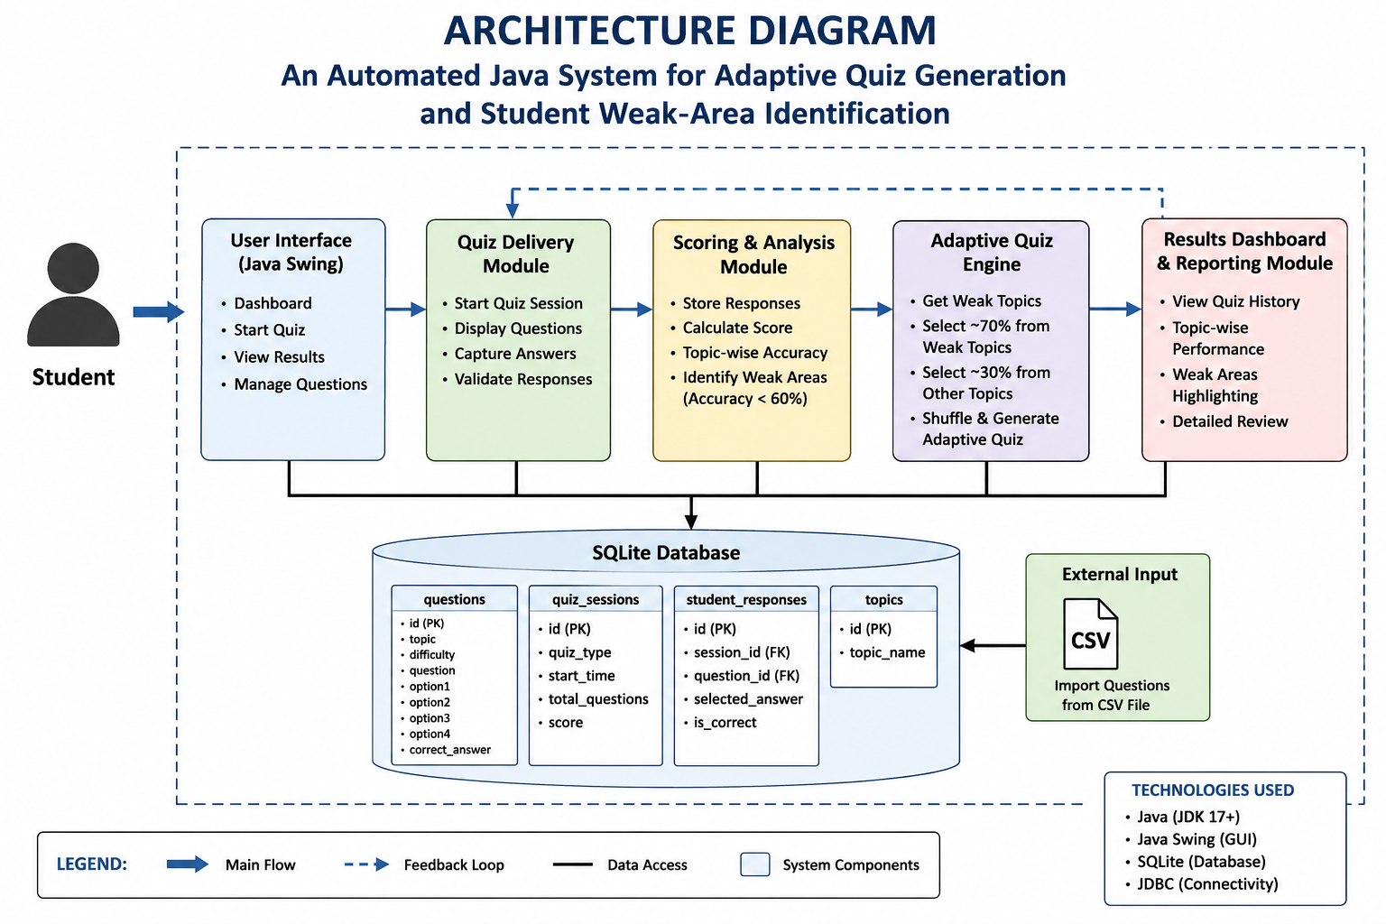

Slide 19
Future Scope
User Authentication: Add login and individual student profiles for multi-user support.
Cloud Deployment: Convert the desktop application into a web-based or cloud-based system.
Real-Time CSV Upload: Allow users to upload question files directly while the application is running.
Improved Question Selection: Generate more balanced random quizzes across different topics.
Enhanced Adaptive Learning: Consider question difficulty and previous attempts for better personalization.
Advanced Reporting: Add graphical charts and detailed progress reports for students and teachers.
Automatic Database Management: Improve database relationships and enable safer automatic deletion of related records.
Mobile Application: Extend the system to Android and other mobile platforms for easier access.

Slide 20
Conclusion
The proposed system successfully implements an automated adaptive quiz system using Java.
It stores and manages quiz questions using SQLite and JDBC.
Student answers are recorded and analyzed to calculate topic-wise performance.
Topics with less than 60% accuracy are automatically identified as weak areas.
The Adaptive Engine generates quizzes with approximately 70% questions from weak topics.
The Results Dashboard helps students review their quiz history and performance.
Overall, the system provides simple, personalized, and targeted learning support without requiring complex statistical or psychometric models.

Slide 21
References
Suresh, K., Kumar, S., Siddik, S., Charaan, R. D., Santhoshkumar, S. P., & Sasikumar, M. (2025, August). AI-Enhanced Learning Assistant Platform with QA Generation, Evaluation, Learning Assessment to Discover Weaknesses and Improve Skills with Recursive Testing. In 2025 5th Asian Conference on Innovation in Technology (ASIANCON) (pp. 1-7). IEEE.
Rajendra, G., Reddy, A. V., Kumar, Y. N. V. N., Reddy, S. S. P., & Sai, K. J. (2026, April). AI-Powered Intelligent Programming Tutor: Adaptive Learning and Auto-Evaluation. In 2026 International Conference on Connected Intelligence for Industrial Applications (CI2A) (pp. 1-6). IEEE.
Redhu, V., Singh, A. K., & Saravanan, M. (2024, March). AI-Enhanced Learning Assistant Platform: An Advanced System for Q&A Generation from Provided Content, Answer Evaluation, Identification of Students' Weak Areas, Recursive Testing for Strengthening Knowledge, Integrated Query Forum, and Expert Chat Support. In 2024 2nd International Conference on Artificial Intelligence and Machine Learning Applications Theme: Healthcare and Internet of Things (AIMLA) (pp. 1-6). IEEE.

Slide 22
Thank you

